Slide 1
Topic: Exponential Growth and Decay
EQ: What is exponential growth and decay?
Ms. Latham

Slide 2
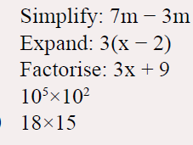
Warm Up Questions:
Topic: Exponential Growth and Decay
EQ: What is exponential growth and decay?
Complete these 5 on your LHS without a calculator.

Slide 3
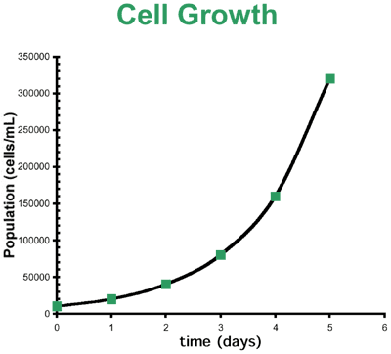
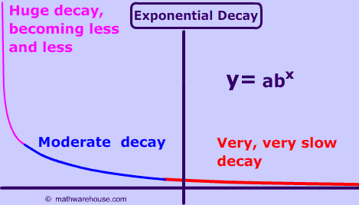


Topic: Exponential Growth and Decay
$$y=a^{x}$$
EQ: What is exponential growth and decay?
Growth
Increasing – a value is larger than 1
Decay
Decreasing – a value is between 0 and 1
“shorter version” of either a really small or really large number
$$2.3 ×{10}^{5}=230000$$
Scientific Notation
How many times you move the decimal place

Slide 4


Zombie Apocalypse
There’s a virus turning people into zombies who attack the living and never die. No one knows where it came from but the first person (known as ‘patient zero’) was an archaeologist who’d just discovered an ancient tomb so it might have come from there.
The virus is spread when infected people bite someone who’s uninfected.
If each zombie bites an average of three uninfected people each day, how long will it take before the entire human population of the planet (which for this problem will be taken as 7 billion people) are turned into shambling undead flesh-munchers?
A: 167 days (almost 6 months).
B: 53 days (just under 8 weeks).
C: 17 days (just over two week).
D: 6 days (less than a week).
Notes:
Pass out the worksheet

Slide 5

Day 1
Patient 0 – 1st Zombie
Day 2
3 zombies
Day 3
9 zombies
Day 4
27 zombies
Day 5
81 zombies
triple
Each day the number of zombies is _____________ the amount of the day before.
Continue the pattern and complete the table on your worksheet.

Slide 6

Zombie Apocalypse
$$Z= {_____}^{D}$$
Number of days
3
Number of zombies
What number should go here?
Days | 1 | 2 | 3 | 4 | 5 | 6 | 7 | 8 | 9 | 10
Zombies | 1
Days | 20 | 30 | 40 | 50 | 60
Zombies
Graph on a piece of graph paper. Remember you pick a few points and connect with a curved line.
Notes:
Pass out the worksheet

Slide 7

Questions
Is this exponential growth or decay?
How many days would it take for all of Baldivis Secondary College to turn into zombies (1800 students)?
How many days would it take for all of Baldivis (31,600)?
How long would it take for all of Australia to turn into zombies (24.6 million)?
Could this exponential growth be sustained forever? Why not?
Was your original guess correct?
A: 167 days (almost 6 months).
B: 53 days (just under 8 weeks).
C: 17 days (just over two week).
D: 6 days (less than a week).
Notes:
Conclusion questions Think – pair - share

